Slide 1
HOSTEL MANAGEMENT SYSTEM
Made by ~
Megha shyam(RA2011002810076)
Shashwath Suvarna (RA2011003010077)

Slide 2
Introduction
The Hostel Management System is a database management system built using SQL developer, with the aim of simplifying the process of accessing and retrieving information related to hostel management. The system provides a user-friendly interface to hostel staff and residents, enabling them to efficiently manage and access information on room allocation, student records, maintenance, and billing. The system uses SQL queries to retrieve and manage data, ensuring data consistency and integrity. It also supports features such as online booking, payment, and messaging to enhance the user experience. The Hostel Management System provides efficient data handling and automation, making it easier for hostel staff to manage day-to-day operations and improve the overall hostel management process. With its easy-to-use interface and powerful SQL-based database management, the system can help hostels provide better services to their residents.

Slide 3
Problem Definition
Hostel management is a complex and time-consuming process that involves several tasks such as room allocation, student records management, maintenance, and billing. The manual management of these tasks is often inefficient, leading to errors and delays in the management process.
problems that the Hostel Management System aims to address are

Slide 4
Problem Definition
Separate System for Booking and Management
The current system for booking rooms and managing hostel operations are separate, leading to inefficiencies and difficulties in coordinating tasks.
The lack of integration between booking and management systems makes it challenging to manage reservations, billing, and other tasks effectively.

Slide 5
Problem Definition
No Separate Page for issues
The current system lacks a portal for reporting and tracking issues such as maintenance requests or complaints.
The lack of a centralized system for managing issues can result in delays in addressing issues and can lead to dissatisfaction among residents.

Slide 6
Problem Definition
Inefficent Billing Process
The manual billing process is often prone to errors and can result in delays in the payment process.
The lack of a centralized system makes it difficult to manage and track billing information, which can lead to inaccuracies and confusion.

Slide 7
Problem Definition
System for reallocation of rooms
The current system lacks an efficient method for re-allocating rooms when necessary, such as when a resident leaves or when changes need to be made to room assignments.
The lack of a centralized system for room re-allocation can result in delays and confusion among residents and staff.

Slide 8
Problem Definition
Separate page for mess information
The current system lacks a portal for managing and sharing mess-related information such as menus, schedules, and feedback.
The lack of a centralized system for mess information can lead to confusion among residents and staff and can result in inefficiencies in managing the mess.

Slide 9
Problem Definition
Separate page for laundry information
The current system lacks a dedicated page for managing and sharing laundry-related information such as schedules, fees, and feedback.
The lack of a centralized system for laundry information can lead to confusion among residents and staff and can result in inefficiencies in managing the laundry facilities.

Slide 10
Objective
The objective of creating a Hostel Management System in DBMS is to design and develop a comprehensive and efficient software system that automates and streamlines the processes involved in managing a hostel. The system should be able to store and retrieve data related to student details, room allocation, fee payments, attendance records, hostel facilities, and complaints, among others. The system should also provide a user-friendly interface for administrators, students, and other hostel staff to access the information and perform necessary operations easily.

Slide 11
Objective
The Hostel Management System should also be scalable and flexible to accommodate future changes and growth. For instance, it should allow for the addition of new hostel facilities, the integration of new payment gateways, and the incorporation of new features based on feedback from hostel staff and students.

Slide 12
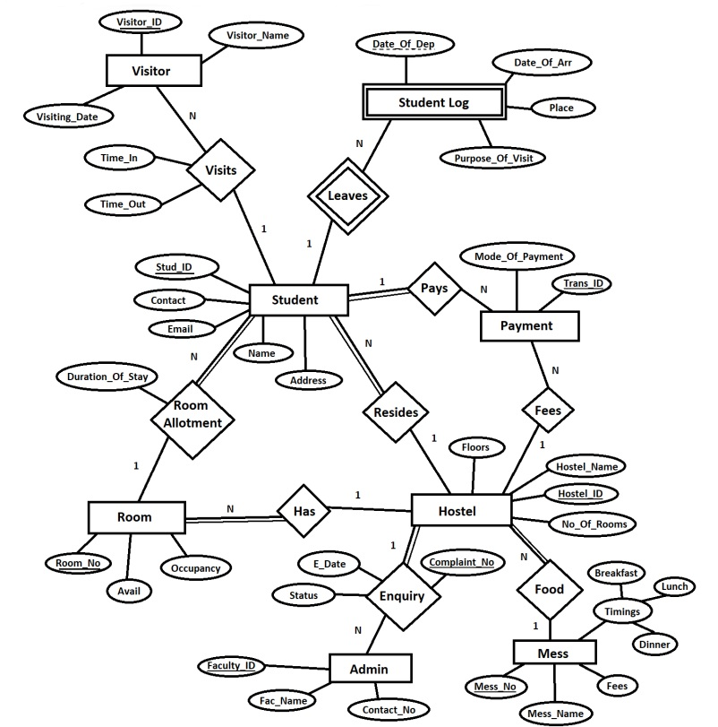
ARCHITECTURE DIAGRAM

Slide 13
Creation Of Tables
Table Mess
CREATE TABLE MESS (
MESS_NAME VARCHAR2(30),
MESS_NO NUMBER PRIMARY KEY,
BREAKFAST VARCHAR2(30),
LUNCH VARCHAR2(30),
DINNER VARCHAR2(30),
FEES NUMBER
);
INSERT INTO MESS VALUES ('IFC A', 201, '7:00 AM - 8:00 AM', '11:30 AM - 12:30
PM', '7:00 PM - 8:00 PM', 200);
INSERT INTO MESS VALUES ('IFC B', 202, '7:30 AM - 8:30 AM', '1:30 PM - 2:30 PM',
'8:00 PM - 9:00 PM', 350);
INSERT INTO MESS VALUES ('IFC C', 203, '7:00 AM - 8:00 AM', '12:00 PM - 1:00
PM', '7:00 PM - 8:00 PM', 175);
INSERT INTO MESS VALUES ('Kaveri', 204, '8:00 AM - 9:00 AM', '11:30 AM - 12:30
PM', '7:00 PM - 8:00 PM', 250);

Slide 14
Creation Of Tables
INSERT INTO MESS VALUES ('Godavari', 205, '7:00 AM - 8:00 AM', '11:30 AM -
12:30 PM', '7:30 PM - 8:30 PM', 300);
INSERT INTO MESS VALUES ('Ganga', 206, '7:00 AM - 8:00 AM', '1:00 PM - 2:00
PM', '8:00 PM - 9:00 PM', 150);
INSERT INTO MESS VALUES ('Yamuna', 207, '7:30 AM - 8:30 AM', '11:30 AM - 12:00
PM', '7:00 PM - 8:00 PM', 225);
INSERT INTO MESS VALUES ('Narmada', 208, '7:00 AM - 8:00 AM', '1:00 PM - 2:00
PM', '8:30 PM - 9:30 PM', 320);
INSERT INTO MESS VALUES ('Indus', 209, '8:30 AM - 9:30 AM', '12:00 PM - 1:00
PM', '7:00 PM - 8:00 PM', 200);
INSERT INTO MESS VALUES ('Krishna', 210, '7:00 AM - 8:00 AM', '12:30 PM - 1:30
PM', '7:30 PM - 8:30 PM', 400);

Slide 15
Creation Of Tables
Table Hostel
CREATE TABLE HOSTEL (
HOSTEL_ID NUMBER PRIMARY KEY,
HOSTEL_NAME VARCHAR2(30),
FLOORS NUMBER,
NO_OF_ROOMS NUMBER,
MESS_NO NUMBER,
FOREIGN KEY (MESS_NO) REFERENCES MESS(MESS_NO)
);
INSERT INTO HOSTEL VALUES(101,'SAROJINI',10,50,201);
INSERT INTO HOSTEL VALUES(102,'PRIYADARSHINI',8,30,203);
INSERT INTO HOSTEL VALUES(103,'1.8K ULTRA MEGA HOSTEL',11,100,201);
INSERT INTO HOSTEL VALUES(104,'1K HOSTEL',12,70,204);
INSERT INTO HOSTEL VALUES(105,'ISH',10,40,202);
INSERT INTO HOSTEL VALUES(106,'BOSE',6,40,203);
INSERT INTO HOSTEL VALUES(107,'AMBEDKAR',12,120,205);

Slide 16
Creation Of Tables
Table Room
CREATE TABLE ROOM (
ROOM_NO NUMBER PRIMARY KEY,
OCCUPANCY NUMBER,
AVAIL VARCHAR2(30),
HOSTEL_ID NUMBER,
FOREIGN KEY(HOSTEL_ID) REFERENCES HOSTEL(HOSTEL_ID)
);
INSERT INTO ROOM VALUES(101, 4, 'YES', 101);
INSERT INTO ROOM VALUES(102, 4, 'YES', 101);
INSERT INTO ROOM VALUES(201, 2, 'YES', 102);
INSERT INTO ROOM VALUES(203, 2, 'NO', 102);
INSERT INTO ROOM VALUES(301, 1, 'NO', 103);
INSERT INTO ROOM VALUES(302, 1, 'YES', 103);
INSERT INTO ROOM VALUES(401, 2, 'YES', 104);
INSERT INTO ROOM VALUES(405, 2, 'YES', 104);

Slide 17
Creation Of Tables
Table Admin
CREATE TABLE ADMIN (
FACULTY_ID NUMBER PRIMARY KEY,
FAC_NAME VARCHAR2(20),
CONTACT_NO NUMBER,
6
HOSTEL_ID NUMBER,
FOREIGN KEY (HOSTEL_ID) REFERENCES HOSTEL(HOSTEL_ID)
)

Slide 18
Creation Of Tables
Table Enquiry
CREATE TABLE ENQUIRY (
COMPLAINT_NO NUMBER PRIMARY KEY,
HOSTEL_ID NUMBER,
FACULTY_ID NUMBER,
E_DATE DATE,
STATUS VARCHAR(20)
FOREIGN KEY(HOSTEL_ID) REFERENCES HOSTEL(HOSTEL_ID),
FOREIGN KEY(FACULTY_ID) REFERENCES ADMIN(FACULTY_ID)
);

Slide 19
Creation Of Tables
Table Student
CREATE TABLE STUDENT (
STUD_ID NUMBER PRIMARY KEY,
NAME VARCHAR2(30),
YEAR_OF_STUDY NUMBER,
CONTACT NUMBER,
EMAIL VARCHAR2(50),
ROOM_NO NUMBER,
ADDRESS VARCHAR2(30),
HOSTEL_ID NUMBER,
FOREIGN KEY(ROOM_NO) REFERENCES ROOM(ROOM_NO),
FOREIGN KEY(HOSTEL_ID) REFERENCES HOSTEL(HOSTEL_ID)
);

Slide 20
Creation Of Tables
Table Payment
CREATE TABLE PAYMENT (
TRANS_ID NUMBER PRIMARY KEY,
MODE_OF_PAYMENT VARCHAR2(20),
HOSTEL_ID NUMBER,
STUD_ID NUMBER,
FOREIGN KEY (HOSTEL_ID) REFERENCES HOSTEL(HOSTEL_ID),
FOREIGN KEY (STUD_ID) REFERENCES STUDENT (STUD_ID)
);

Slide 21
Creation Of Tables
Table Visitor
CREATE TABLE VISITOR(
VISITOR_ID NUMBER PRIMARY KEY NOT NULL,
VISITOR_NAME VARCHAR2(50) NOT NULL,
STUD_ID NUMBER,
VISITING_DATE DATE,
TIME_IN VARCHAR2(15),
TIME_OUT VARCHAR2(15),
FOREIGN KEY (STUD_ID) REFERENCES STUDENT(STUD_ID)
);

Slide 22
Creation Of Tables
Table Student_log
CREATE TABLE STUDENT_LOG(
STUD_ID NUMBER,
DATE_OF_DEP DATE,
DATE_OF_ARR DATE,
PLACE VARCHAR2(30),
PURPOSE_OF_VISIT VARCHAR2(30),
PRIMARY KEY(STUD_ID, DATE_OF_DEP),
FOREIGN KEY (STUD_ID) REFERENCES STUDENT(STUD_ID)
);

